Slide 1
The Business Analysis Process Model
Notes:
This presentation was automatically generated by PowerPoint Copilot based on content found in this document: https://1drv.ms/w/c/1c3ede0d57884f42/EamE7DDgi2lHu-cZnxcJ6XwB4ic3PGV2mYkDijuziFJmLg?e=D4Bxgg AI-generated content may be incorrect.

Slide 2
Agenda
Introduction
An Approach to Problem Solving
The Business Analysis Process Model
Investigate Situation
Investigation Techniques
Documenting Business Situations
Consider Perspectives
Analyse Needs
Evaluate Options
Define Requirements
Deliver Changes
Summary
Notes:
Agenda * Overview of Business Analysis Process Model * An Approach to Problem Solving * Creative Problem Solving * Data Finding * The Business Analysis Process Model * Understanding Business Context * Key Stages of Business Analysis Project * Investigate Situation * OSCAR Mnemonic * Clarifying Objectives * Range of Investigative Approaches * Documenting Business Situations * Techniques for Documenting and Visualising * Stage Summary * Consider Perspectives * Stakeholder Identification and Analysis * Stakeholder Perspectives * Business Activity Modelling * Stage Summary * Analyse Needs * Gap Analysis * Analysing Activities * Analysing Business Processes * Stage Summary * Evaluate Options * Stage Summary * Identify Potential Options * Define Requirements * Stage Summary * Requirements Engineering * Deliver Changes * Stage Summary * Delivering the Requirements * Summary of Business Analysis Projects

Slide 3
Introduction
Tools and Techniques for Business Analysts
Various tools available for business analysis
Techniques to determine the most appropriate tool
Overview Framework
Contextual placement of tools and techniques
Helps in determining the best technique for each situation
Business Analysis Process Model
Framework for standard modelling techniques
Incorporates organisational templates
Requirements Engineering Principles
Highlights best practices
Defines system requirements effectively
Notes:
Business analysts have various tools and techniques at their disposal. An overview framework helps place these tools in context and determine the best technique for each situation. The Business Analysis Process Model serves as a framework for standard modelling techniques and organisational templates, incorporating Requirements Engineering principles to highlight best practices in defining system requirements. Original Content: There are many tools and techniques available for the business analyst to use and, because of the nature of business analysis work, an overview framework is useful to place these in context and help determine the most appropriate technique for each individual situation. In this chapter we have set out a Business Analysis Process Model as a framework within which both standard modelling techniques and organisational templates can be used. This approach also incorporates the principles of Requirements Engineering to highlight best practice when defining system requirements.

Slide 4
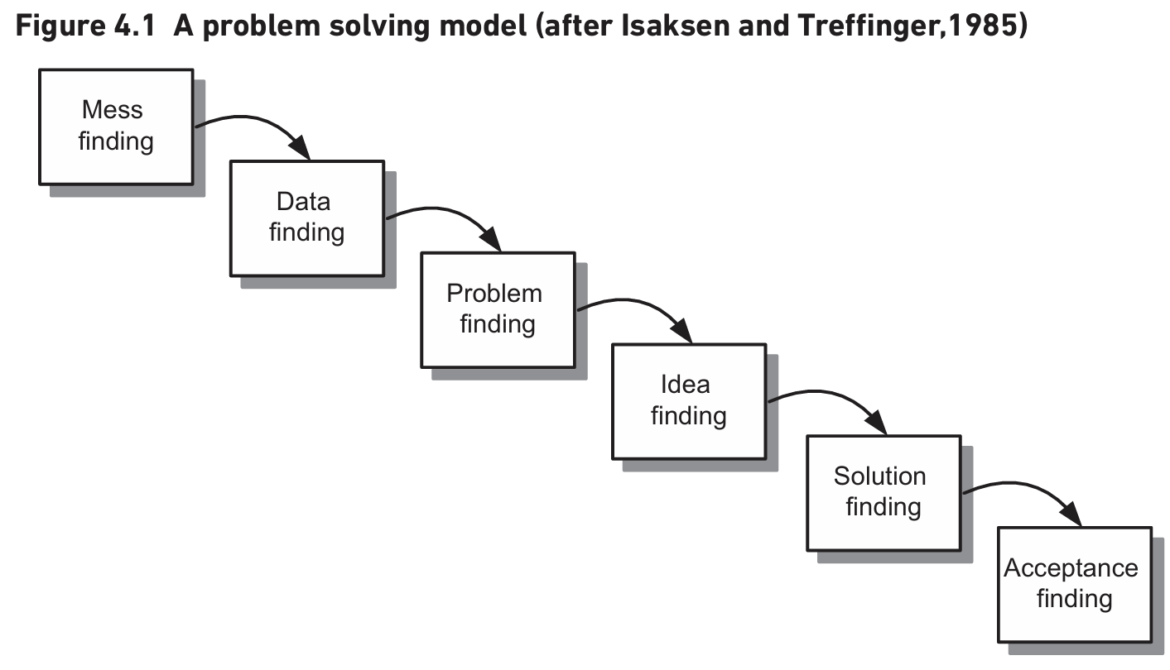
Creative Problem Solving
Importance of Creative Problem Solving
Vital for developing innovative ideas
Responds to changes in business environment
Challenges in Creative Problem Solving
Pressure to produce ideas quickly
Difficulty in generating creative solutions
Isaksen and Treffinger’s Model
Framework for understanding problems
Emphasizes investigation and analysis
Mess Finding Stage
Initial stage in problem investigation
Tools for Documenting and Analyzing
Notes:
Creative problem solving is crucial for business managers to develop innovative solutions. Isaksen and Treffinger’s model emphasizes thorough investigation and analysis. The mess finding stage helps understand complex problems. Tools like rich picture diagrams, mind maps, and fishbone diagrams are useful for documenting and analyzing issues. Original Content: One of the requirements of business managers is that business analysts examine the entire business area and take a thoughtful, even creative, approach to developing ideas for solutions. Creative problem solving is vital in the business world as, increasingly, organisations need to develop innovative ideas in order to respond to changes in the business environment including actions from competitors. However, many people find this difficult; often because they feel under pressure to produce ideas very quickly. In this context, Isaksen and Treffinger’s (1985) original creative problem solving model, shown in Figure 4.1, provides a useful framework for understanding problems and developing creative solutions, particularly as the model emphasises the need to investigate and analyse rather than leap to quick, possibly premature, solutions. This model proposes an approach that may be applied usefully to business analysis. In this section we describe the implications and suggestions the model has for you as a business analyst. The first stage, mess finding, is where we often begin when undertaking a problem investigation. In business analysis this stage is concerned with f inding out about the complexity of the problem situation. Many problems are poorly defined or ambiguous, and each problem situation is likely to be complex and contain various issues and concerns. In other words, there is likely to be a ‘mess’ and different situations will have different components to that mess. Identifying this as the starting point in this model helps to emphasise that you need to gain some understanding about the complete situation before diving into options and solutions. The rich picture diagram, described in Chapter 5, is particularly useful to help document and analyse the ‘mess’ in problematic business situations. Rich pictures do not use a defined notation set and the f lexibility this offers enables us to use them to represent any situation. Mind maps and f ishbone diagrams are also described in Chapter 5 and are similarly helpful.

Slide 5
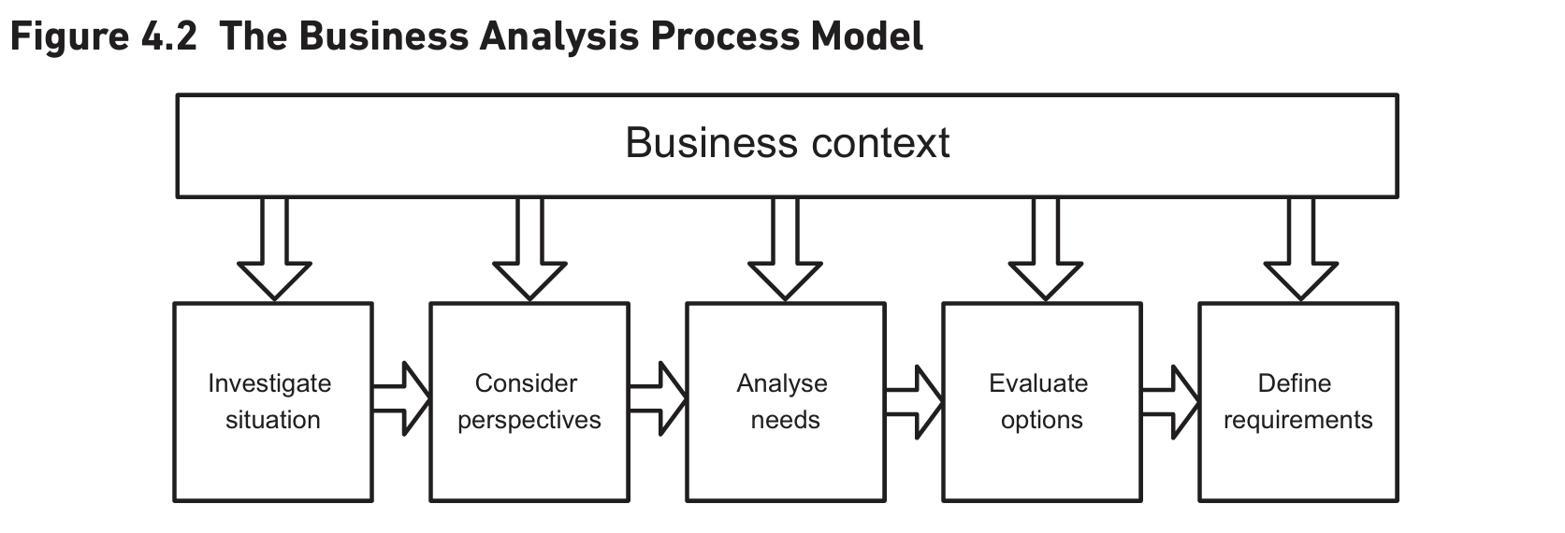
Data Finding

Slide 6
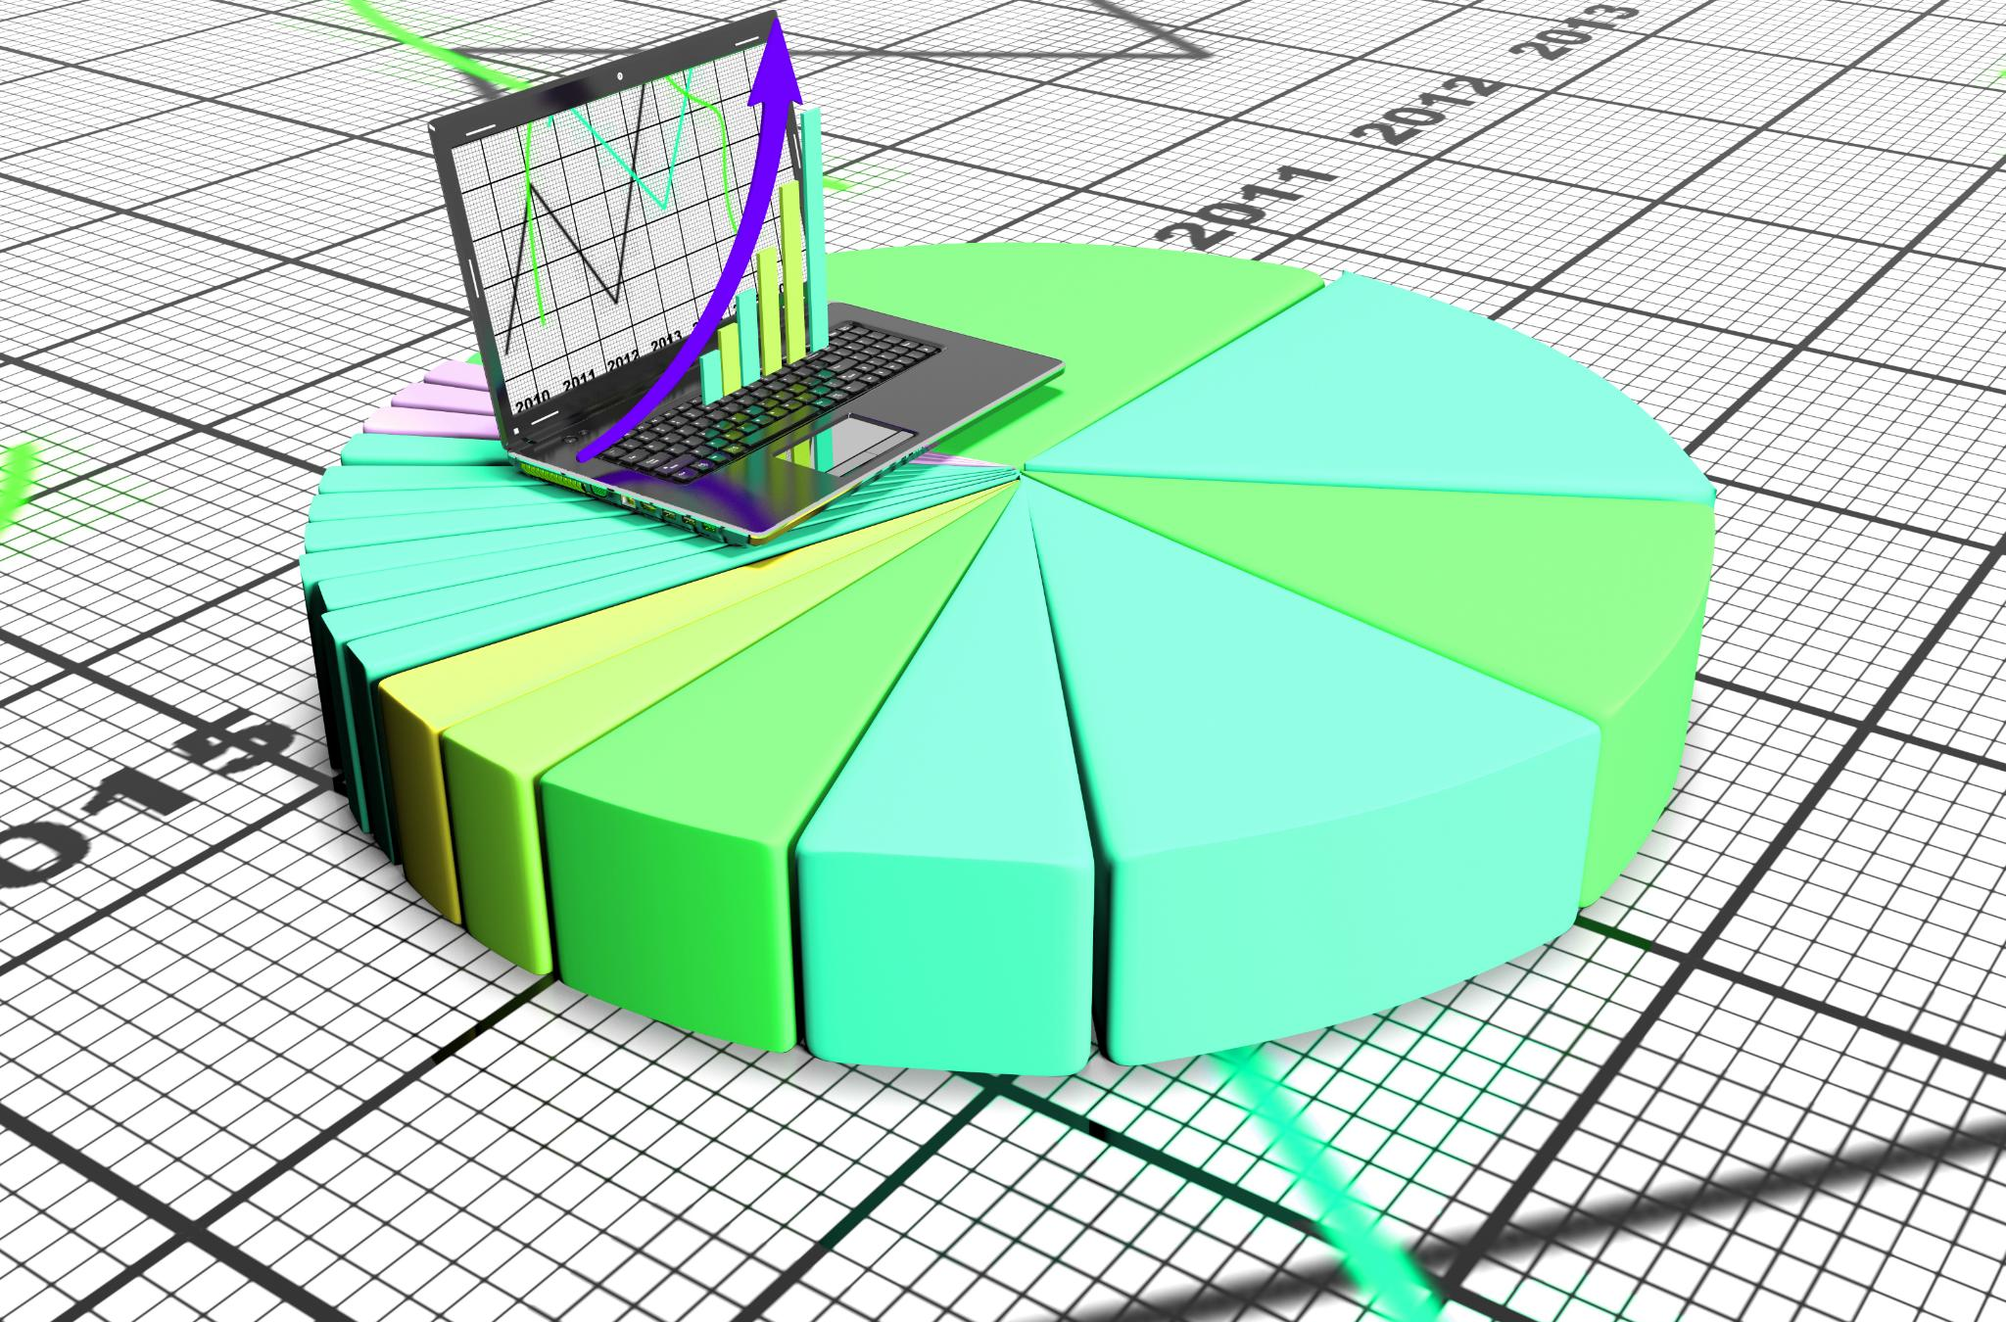
Understanding Business Context
Importance of Business Context
Understanding Mission, Objective, Strategy, and Tactics (MOST)
Recognizing underlying values of the organization
Organizational Values
Quality and customer service
Low costs
Compliance with legislation regarding equality of access
Embracing accessibility for all
Stakeholder Priorities
Clear understanding of stakeholders
Awareness of their priorities
Notes:
Understanding the business context is crucial in process models. We need to be aware of the Mission, Objective, Strategy, and Tactics (MOST) and recognize the organization's values, such as quality, customer service, and compliance with legislation. This helps in understanding stakeholders and their priorities. Original Content: The top stripe of the process model shows the importance of understanding the business context. Within this context, we need to be aware of the Mission, Objective, Strategy and Tactics (MOST), as described in Chapter 3. However, there is a more fundamental aspect of which we should also be aware and this concerns the underlying values of the organisation. For example, does the organisation genuinely value aspects such as quality and customer service? Or, are low costs more important? Does it comply where necessary with legislation regarding equality of access or really embrace the importance of accessibility for all? Recognising the values of the organisation and being aware of the MOST, will help us to have a clearer understanding of the stakeholders and their priorities.

Slide 7
Key Stages of Business Analysis Project
Key Stages of Business Analysis Projects
Each stage represents areas to be considered
Projects may require detailed exploration of all stages or focus on a subset
Determining the Focus
Decide what the focus is and which areas need investigation
Example: exploring improvements in organizational work
Analyzing Current Practices
Examine current working practices, staffing, and job roles
Focus on analyzing and evaluating future business system options
IT System Needs
Understanding the situation and stakeholder perspectives
Potential use of IT to improve the business system
Notes:
Business analysis projects involve key stages that need consideration. Some projects explore all stages, while others focus on specific areas. Determining the focus is crucial, such as improving organizational work or IT system needs. Analyzing current practices and evaluating future options are essential steps. Original Content: The process model sets out the key stages for a business analysis project with each stage representing the areas that need to be considered. However, it should be noted that whilst some projects may require a detailed exploration of all of the stages, other projects may focus on a subset of the model, possibly just one stage. One of the most important aspects of a business analysis project is to decide what the focus is and which areas need to be investigated. For example, on some projects the focus may be to explore possible improvements to how part of the organisation works. In this case, we might begin by examining all of the current working practices, including the staffing and job roles, and the work may focus on analysing and evaluating the options for the future business system. Another project may focus on the IT system needs and whilst understanding the situation and all of the stakeholder perspectives is important, the potential for the use of IT to improve the business system will dominate the analysis. The rest of this chapter describes the stages of this process model.

Slide 8
OSCAR Mnemonic
Uncovering Issues and Problems
Identify and clarify issues within the business
Set context for business analysis work
Terms of Reference
Project initiation document needed
Defines context for analysis
OSCAR Mnemonic
Objectives: Business and project goals
Scope: Area to be investigated and deliverables
Constraints: Time, budget, and policy limitations
Authority: Person responsible for deliverables
Resources: Human and physical resources available
Notes:
The Investigate Situation stage focuses on identifying issues within the business. Terms of reference or a project initiation document set the context for analysis. The OSCAR mnemonic helps clarify objectives, scope, constraints, authority, and resources. Original Content: INVESTIGATE SITUATION This stage is concerned with uncovering issues and problems. The terms of reference for the project, or possibly a more detailed project initiation document, are needed in order to set out the context within which the business analysis work will take place. The OSCAR mnemonic can be very useful when clarifying the terms of reference if none exist. This stands for the following: Objectives: The business and project objectives to be achieved Scope: The area of the business to be investigated and the required deliverables Constraints: The time, budgetary and policy constraints within which the work must be conducted Authority: The person who is responsible for receiving the deliverables and agreeing that the work has been completed Resources: The resources, both human and physical, available to the project.

Slide 9
Clarifying Objectives
Importance of Clarifying Objectives
Tailoring the approach to the study
Requires skill and precision
Initial Period of Business Analysis
Presented with a statement of 'the problem'
Investigate further to find real issues
Avoiding False Assumptions
Do not accept information without question
Understand business context during investigation
Creating Documentation
Record findings for future reference
Help team members understand the situation
Notes:
A business analyst must clarify the study's objectives and tailor the approach accordingly. Investigate the situation to find real problems and avoid false assumptions. Understand the business context and create documentation to record findings and help the team. Original Content: A key area for the analyst is to clarify the objectives of the study and tailor the approach accordingly – often a task that requires a good deal of skill. During the initial period of business analysis work the analyst may be presented with a statement of ‘the problem’ but this statement may not be correct. It is important to investigate the situation further in order to determine where the real problems lie, and ensure that symptoms of the problems are not confused with the real issues. It is also vital that the analyst does not make false assumptions or accept all of the information provided without question. To perform this work effectively, it is important that the business analyst has an understanding of the business context during the investigation stage. Once the analyst has begun to understand the situation and clarify some of the ambiguity that exists, it will be necessary to create documentation recording the findings. This will be required for future reference and also to help other members of the team understand the situation.

Slide 10
Investigation Techniques
Choosing Appropriate Investigative Approaches
Consider the range of possible approaches
Select those most suitable for the work in hand
Level of Detail Required
Varies depending on the focus of the analysis
Overall Appreciation of Business Area
Identify key stakeholders
Understand their views and opinions
Appreciate the nature of the work
Useful techniques: interviewing, observation, workshops
Eliciting Detailed Information
Quantifying Subjective Information
Notes:
Business analysts use various investigative approaches, detailed in Chapter 5. Selecting the right approach depends on the analysis focus. For overall business understanding, techniques like interviewing and workshops are useful. For detailed information, document analysis and prototyping are better. Subjective information should be quantified using record searching or surveys. Original Content: There are many investigative approaches that business analysts can use and these are explored in detail in Chapter 5. It is important that we consider the range of possible investigative approaches and choose those that are most appropriate to the work in hand. The level of detail required during this stage may vary considerably depending on the focus of the business analysis work. If the analyst is trying to gain an overall appreciation of the business area, for example, to identify the key stakeholders and acquire an understanding of their views and opinions, or to appreciate the nature of the work and the range of people and skills, then often the techniques used will be those that provide an overall perspective and generalised view; interviewing, observation and workshops would be particularly useful. However, if the work is concerned with eliciting more detailed information such as data requirements or the flow of a business process then the most appropriate fact-finding techniques are those that focus on the detail such as document analysis, scenario analysis or prototyping. Much of the information gained during the initial investigation may be subjective, so should be quantified through more detailed analysis. In this case, techniques such as record searching or surveys may be very useful in order to quantify some of the information put forward.

Slide 11

Techniques for Documenting and Visualising
High-level overview of the situation
Required during initial investigation
Useful for complex issues from different causes
Rich picture
Captures the essence of a situation
Mind map
Allows structuring of information
Fishbone diagrams
Uncover root causes of problems
Other techniques for specific issues
Process modelling for business process issues
Notes:
During the initial investigation of a business system, various techniques can be employed. A high-level overview is essential for complex issues. Rich pictures and mind maps help structure information, while fishbone diagrams uncover root causes. For specific issues, process modelling is useful. Original Content: There are a number of useful techniques for documenting and visualising the initial investigation of a business system. It is typical that a high-level overview of the situation will be required during the initial investigation, particularly where the issues are complex and originate from different causes. As we mentioned earlier, a ‘rich picture’ can be very useful in capturing the essence of a situation. An alternative, but similar approach, is the ‘mind map’; this also allows for a degree of structuring of the information. Fishbone diagrams can also be very useful during investigation as they help to uncover the root causes of problems. These techniques are described in further detail in Chapter 5. Other techniques may also be useful where specific issues have been identified. For example, if there are issues with the business processes then process modelling (described in Chapter 7) will be relevant.

Slide 12
Stage Summary
Procedure
Study background material
Carry out initial investigation with key stakeholders
Document results using meeting reports and diagrams
Inputs
Terms of reference or project initiation document
MOST, statement of business values
Outputs
View of the existing business situation
List of issues/problems
Techniques
Investigation techniques: interviewing, observation, workshops
Notes:
The investigation procedure involves studying background material, conducting initial investigations, and documenting results. Inputs include project documents and business values. Outputs are views of the business situation and a list of issues. Techniques used are interviews, observations, workshops, surveys, and various diagrams. Original Content: Procedure Study background material – project initiation document, terms of reference Carry out initial investigation with key stakeholders Document the results of the investigation – using meeting reports plus diagrams such as a ‘rich picture’, mind-map or fishbone diagrams Inputs Terms of reference or project initiation document MOST, statement of business values Outputs View of the existing business situation, including meeting reports and diagrams such as rich pictures, mind maps and fishbone diagrams List of issues/problems Techniques Investigation techniques such as interviewing, observation and workshops Quantitative investigation techniques such as surveys, sampling and document analysis ‘Rich pictures’ (from Soft Systems Methodology, developed by Checkland (1999)) Mind maps (Buzan and Buzan, 2009) y Spaghetti maps Fishbone diagrams (Ishikawa – these are also known as Ishikawa diagrams after their inventor Kaoru Ishikawa (1985)) Business process models

Slide 13

Stakeholder Identification and Analysis
Varied Impact on Individuals and Organisations
Different levels of interest and power among stakeholders
Directly affected stakeholders may hold strong views
Indirectly Affected Stakeholders
Less concerned about the nature of the new system
May still have opinions on changes
Stakeholder Analysis and Management
Discussed in detail in Chapter 6
Mechanisms for effective stakeholder management
Notes:
Business situations impact various stakeholders differently. Some are directly affected and hold strong views, while others are indirectly affected and less concerned. Stakeholder analysis and management are crucial, as discussed in Chapter 6. Original Content: Every business situation will affect a range of individuals and organisations. Among this group there will be people or groups with varying levels of interest and power. Some stakeholders may be directly affected by any recommendations and may hold strong views on how the systems and working practices should be changed. Others may be affected only indirectly and, whilst having opinions, may be less concerned about the nature of the new system. The range of possible stakeholders and mechanisms for stakeholder analysis and management are discussed in detail in Chapter 6.

Slide 14
Stakeholder Perspectives
Different Views on Business Systems
Stakeholders have varying opinions on what is important
These views can lead to hidden agendas and conflicts
Potential for Conflicts
Conflicts arise from contradictory views
Inconsistent priorities can emerge
Role of Business Analysts
Awareness of potential conflicts is crucial
Alertness to situations where conflicts might arise
Detecting Stakeholder Conflicts
Resolving Conflicts
Chapter 6 Insights
Notes:
Stakeholders often have different views on business systems, leading to conflicts and hidden agendas. Business analysts must be aware of these potential conflicts and understand stakeholders' values and beliefs. Chapter 6 explains the importance of analysing stakeholders and introduces the CATWOE technique. Original Content: Stakeholders often have different views on what is important about a business system and, as a result, have different ideas about the improvements that are needed. These views are often contradictory and can lead to hidden agendas, conflicts and inconsistent priorities. As business analysts it is important that we are aware of the potential for such conflicts and are alert to situations where these might arise. We can often detect where the different stakeholder conflicts might originate by considering the underlying set of values and beliefs they hold. For example, we might reflect on what an individual stakeholder considers to be the main focus of the business system and, critically, why this is the case. Understanding these values and beliefs allows the analyst to approach issues and problems from an informed position and hence have an improved chance of resolving the situation. Chapter 6 considers the importance of analysing stakeholders and their perspectives and explains how they may be analysed by considering the world view of each stakeholder. This includes an explanation of the CATWOE technique, originally developed by Checkland (1999).

Slide 15
Business Activity Modelling
Conceptual Model Development
Based on Checkland’s work and extended by Wilson (1990)
Allows analysts to build a business system model from stakeholder perspectives
Quality-focused Perspective
Recruitment and development of highly skilled staff
Introduction of customer-focused processes
Monitoring of customer satisfaction levels
No Frills Perspective
Keeping costs low
Monitoring the number of attendees at events
Business Activity Modelling Technique
Helps determine priorities and focus of the business system
Notes:
Stakeholder perspectives can be analyzed by considering the required business activities. Quality-focused perspectives emphasize skilled staff, customer-focused processes, and satisfaction monitoring. No frills perspectives focus on low costs and attendee monitoring. This technique helps prioritize and focus the business system, potentially synthesizing multiple views. Original Content: The stakeholder perspectives can be analysed further by considering the business activities that would be required to fulfil a particular perspective. This approach, developed from Checkland’s work, and extended by Wilson (1990), allows analysts to build a conceptual model of a business system as envisaged by a particular stakeholder. For example, where a manager believes an events organisation should focus on quality then there would be an emphasis on activities such as: the recruitment and development of highly skilled staff; the introduction of customer-focused processes; monitoring of customer satisfaction levels. An alternative view could be that the focus should be on ‘no frills’ events and in this system the emphasis would be on the following activities: keeping costs low; monitoring the number of attendees at events. This approach allows business analysts to consider where the priorities lie and what the focus of the new, improved business system should be. One stakeholder’s view may take precedence over the others or several models may be synthesised to provide an agreed business activity model. The business activity modelling technique is explained further in Chapter 6.

Slide 16
Stage Summary
Objectives
Take stock of stakeholder perspectives
Analyze values and beliefs
Develop business activity models
Manage stakeholders for narrow remit projects
Procedure
Identify key stakeholders
Investigate values, beliefs, and priorities
Develop and analyze perspectives
Inputs
Outputs
Techniques
Notes:
The objective is to understand stakeholder perspectives and develop business activity models. The procedure involves identifying stakeholders, investigating their values, and resolving conflicts. Inputs include project documents and stakeholder information. Outputs are various models and perspectives. Techniques involve investigation, negotiation, and analysis. Original Content: Objectives The objective of this stage is to take stock of the range of stakeholder perspectives about the business system under investigation. These perspectives may then be analysed to uncover stakeholder values and beliefs, and developed into business activity models. However, where there is a narrow remit for the business analysis work, for example if we are concerned primarily with improving a particular process, while it will be important to identify and manage the stakeholders, consideration of the entire business system may be beyond the scope of the business analysis work. Procedure Identify key stakeholders whose perspectives are important to the business analysis project Investigate the values, beliefs and priorities of the key stakeholders Develop and analyse the stakeholder perspectives Build conceptual models of activities to fulfil the stakeholder perspectives Explore and resolve conflicts between stakeholder perspectives Synthesise conceptual models into one view of the desired business system Inputs Terms of reference or project initiation document Business values and MOST y Identified stakeholders (from the documentation of the existing business system) Outputs Power/Interest grid Stakeholder perspectives Business activity models based upon stakeholder perspectives Consensus business activity model Techniques Investigation and negotiation techniques Stakeholder identification and analysis CATWOE y Business Activity Modelling

Slide 17
Gap Analysis
Focus on identifying improvements
Analyze current business system
Compare with desired future system
Approach used: Gap Analysis
Contrast current 'as is' view with future 'to be' system
Difference from traditional methods
Traditional methods add new features to existing procedures
Gap analysis emphasizes understanding desired state
Objective of gap analysis
Identify changes needed to achieve desired state
Notes:
This stage focuses on identifying improvements to the business system using gap analysis. We compare the current system with the desired future system to identify necessary changes. Unlike traditional methods, gap analysis emphasizes understanding the desired state and identifying changes to achieve it. Original Content: The focus of this stage is to identify where improvements can be made to the business system. The approach used is known as ‘gap analysis’ whereby a current or ‘as is’ view is compared with a desired, future or ‘to be’ system. This method contrasts with the traditional, more systematic approach to business or systems improvement where new features are added on to an existing set of procedures or IT system functions. With gap analysis the emphasis is on understanding where we want to be and, by looking at where we are now, identify what needs to change to take us there.

Slide 18
Analysing Activities
Detailed Analysis of Business Activities
Examine each activity in turn
Identify issues needing solutions
Conceptual Picture of Desired Business Activities
Shows where current system is lacking
Varied gaps from activity to activity
Current Business System Evaluation
Some activities satisfactory
Others inadequate or non-existent
Support from Information Systems
Potential for Change
Scope of Business Analysis Work
Notes:
The business activity model helps analyze each activity, identifying issues and gaps in the current system. It shows where improvements are needed and evaluates the support from information systems. This analysis determines the potential and degree of change required, although some aspects may be beyond the scope of the business analysis work. Original Content: Where you have developed a business activity model from a stakeholder perspective, this can be used to carry out a detailed analysis of the desired business system by examining each activity in turn. This analysis allows us to identify where there are issues that need to be addressed in any solution that we recommend. As the model provides a conceptual picture of the desired business activities it allows the business analyst to see where the current business system is lacking. When examining the model, the range and extent of the gaps found will vary from activity to activity. Some activities may be in place and operating satisfactorily. However, others may be inadequate in the current business system and some may not exist at all. There may be good support for the activity from the organisation’s information systems or this may be poor and in need of improvement. Identifying the gaps at this level will help us to determine the potential for change to the business system and the degree to which this is required. The business activity model may identify a range of areas to be considered in the light of the current business situation. However, it is possible that some aspects may be beyond the scope of the business analysis work.

Slide 19
Analysing Business Processes
Focus on Business Processes
Activities modelled on business activity model show conceptual view
Business process models show how work is carried out
Business Process Initiation
Initiated by a business event or 'trigger'
Concludes when the goal is achieved
Results-Oriented View
Cuts across departments and job roles
Focused on meeting customer needs
Approach to Modelling
Redesigning Processes
Gap Analysis
Notes:
Gap analysis focuses on business processes within the business system. It involves modelling current processes and considering changes to achieve desired outcomes. This results-oriented approach cuts across departments and job roles. The goal is to identify gaps and make necessary changes in structure, skills, processes, or technology. Original Content: At a more detailed level, gap analysis focuses on the business processes that are applied within the business system. Whereas the activities modelled on the business activity model show a conceptual view of what activities should be within the desired business system, the business process models allow us to consider how the work is carried out. Therefore, the analysis is conducted at a more specific level of detail and, rather than being conceptual, is much closer to the physical reality of the business system. A business process is initiated by a business event, which is sometimes called a ‘trigger’, and concludes when the goal of the process has been achieved. This view of the business situation cuts across departments and job roles in order to show a more results-oriented view that is focused on meeting customer needs. The approach we take to this work is to model the current business process and then to consider possible changes to the process before finalising the required process. Hence, we develop a current or ‘as is’ model that provides a basis for developing the required or ‘to be’ model. When redesigning a process we can look for small changes that affect one or two process steps or we might decide to design a completely new process. The business process modelling technique is explored in further detail in Chapter 7. Gap analysis is conducted as a comparison between the current and desired business systems. The objective is to identify areas where action is needed to deal with the gaps. This may require changes to the organisation structure, people skills, processes or technology. Chapter 8 considers gap analysis and the importance of aligning any changes with the business architecture for the organisation.

Slide 20
Stage Summary
Analysis of Activities
Identified areas of weakness
Business Process Models
'As is' and 'to be' models
Potential Improvements
List of improvements to the business system
Techniques Used
Gap analysis
Stage Summary
Objectives
Procedure
Inputs
Notes:
This slide covers the analysis of activities, business process models, and potential improvements. Techniques like gap analysis and business process modelling are used. Objectives include exploring differences and identifying opportunities for change. The procedure involves examining activities, developing models, and analysing gaps. Inputs include business activity models and values. Original Content: Analysis of activities, including identified areas of weakness ‘As is’ and ‘to be’ business process models List of potential improvements to the business system Techniques Gap analysis Activity analysis Business process modelling Stage summary Objectives To explore the differences between the current and desired situations. To identify the opportunities for business change by analysing these differences or ‘gaps’. Procedure Examine the activities on the business activity model Consider how well each activity is carried out in the current business system and how well it is supported by the organisation’s information systems Identify the key business events to be handled within the business system; develop ‘as is’ business process models for the key business events Develop ‘to be’ business process models for the key business events Analyse the gaps between the existing and the desired business systems. Use these as a basis for identifying potential business system improvements Ensure any potential improvements align with the business architecture Inputs Agreed business activity model View of the existing business system Business values and MOST Outputs

Slide 21
Stage Summary
Objectives
Collect potential changes into packages of improvement actions
Develop and document a set of options in detail
Present options to business managers for consideration
Procedure
Identify range of business options
Explore acceptability and reduce to a shortlist
Develop and document each option in detail
Consider business, technical, and financial feasibility
Inputs
Outputs
Techniques
Notes:
This stage aims to gather potential changes into improvement packages. We identify business options, explore their acceptability, and develop detailed documentation. Inputs include project documents and business values. Outputs are a shortlist of options and a business case. Techniques involve cost-benefit, impact, and risk analysis. Original Content: Stage summary Objectives The objective of this stage is to collect together the range of potential changes into packages of improvement actions. These packages form the basis for developing a set of options that are then developed and documented in further detail. They are then presented to business managers for consideration. Procedure Identify range of business options Explore acceptability of options and reduce to a shortlist Develop and document each option in detail. In particular, consider the business, technical and financial feasibility of each option Develop business case, including presenting options and recommendations to business managers Inputs Project initiation document/terms of reference Business values and MOST List of potential improvements to the business system Outputs Shortlist of business options Business case including options, feasibility assessment and recommendations Techniques Business options identification Cost–benefit analysis, including quantification of costs and benefits; investment appraisal techniques Impact analysis Risk analysis

Slide 22
Identify Potential Options

Slide 23
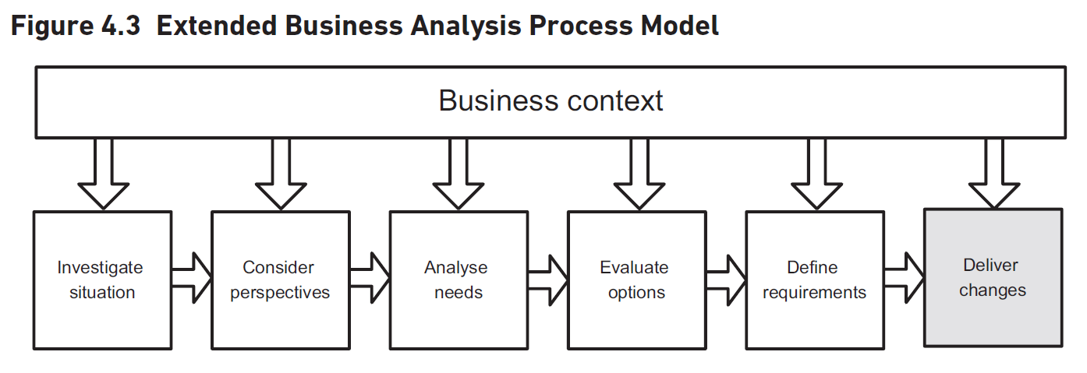
Stage Summary
Objectives
Produce a well-formed requirements document
Include clear textual descriptions of requirements
Trace each requirement from origin to resolution
Use modelling techniques for clarity
Procedure
Gather requirements
Document requirements
Inputs
Outputs
Techniques
Resources
Notes:
This stage aims to produce a comprehensive requirements document for the new business system. The procedure involves gathering, documenting, and validating requirements, including business process models and IT data models. Inputs include selected options and business values, while outputs feature process models and validated requirements documents. Techniques used are business process modelling and requirements analysis. Original Content: Stage summary Objectives The objective of this stage is to produce a well-formed requirements document setting out the business requirements for the new business system. This document must include clear textual descriptions of the requirements and sufficient information to trace each requirement from its origin through to its resolution. Modelling techniques may be used to represent the process and data requirements diagrammatically and hence improve the rigour and clarity of the requirements definition. Procedure Gather the requirements: elicit and analyse the business requirements for the new business system; document and manage the requirements; validate the documented requirements. Document the requirements for the new business system, including as appro priate: business process models; catalogue of business requirements; models of the IT processing and data; glossary of terms. Inputs Selected option for revised business system Business values and MOST Terms of reference/project initiation document Outputs ‘To be’ process models y Job definitions Revised organisational structure Validated requirements document including: requirements catalogue; models of business process and system requirements; glossary of terms. Techniques Business process modelling Job design Investigation techniques Requirements elicitation, analysis and validation Requirements documentation and management Resources: The resources, both human and physical, available to the project.

Slide 24
Requirements Engineering

Slide 25
Stage Summary
Stage Summary
Decide the lifecycle and approach to be adopted
Design and develop the business change solution
Support planning and implementation
Develop learning materials and deliver training
Review predicted benefits
Identify actions to realise benefits
Inputs
Business change process and organisation design
IT software solution
Outputs
Techniques
Notes:
The business change lifecycle involves deciding the approach, designing solutions, supporting implementation, and reviewing benefits. Inputs include process design, IT solutions, and business cases. Outputs are plans, communication strategies, training materials, revised roles, and benefits documents. Techniques used are use case descriptions, decision tables, state charts, and benefits planning. Original Content: Stage summary Procedure Decide the lifecycle and approach to be adopted Design and develop the business change solution Support the planning and implementation, in particular the development of the required learning materials and the delivery of training for the business staff Review the predicted benefit Identify any actions required to realise the benefits Inputs Business change process and organisation design IT software solution Business case Outputs Business change plan Communication plan Training approach and materials Revised job roles and descriptions Benefits plan Benefits review document Techniques Use case descriptions Decision tables State charts Benefits planning

Slide 26
Delivering the Requirements

Slide 27

Summary
Improving Working Practices
Enhancing staff capability
Optimizing business processes
Upgrading supporting information systems
Supporting Development of Solutions
Delivering business changes
Realizing business benefits
Business Analysis Process Model
Structuring and conducting assignments
References to popular techniques
Identifying useful techniques
Notes:
Business analysis projects aim to improve working practices within business systems. This includes enhancing staff capability, optimizing processes, and upgrading information systems. Business analysts also support solution development, business changes, and benefit realization. The process model helps structure assignments and references useful techniques. Original Content: Business analysis projects are usually concerned with improving the working practices within business systems. This may involve changes to a range of aspects that form the business system including staff capability, business processes or the supporting information systems. Increasingly, business analysts are also required to support the development of solutions, delivery of business changes and realisation of business benefits. The business analysis process model is intended to help business analysts in deciding how to structure and conduct their assignments. The model also includes references to some of the techniques in popular use and identifies when these techniques may be particularly useful.

